Slide 1

Attendance Management System

Slide 2
Group Details
Group Number : 18
Group Members :
  2020/ICTS/19 – K.K.A.M.Suraweera
  2020/ICTS/54 - D.M.V.Charuni
  2020/ICTS/128 – U.D.D.Jayathilaka
  2020/ICTS/146 - W.C.H.Silva
  2020/ICTS/147 - R.M.P.G.V.S.Dissanayake

Slide 3
Content
Introduction about OOP
OOP Concepts
Inheritance
Polymorphism
Encapsulation
Abstraction
Class
Object
About our project

Slide 4
Introduction about OOP
Object-oriented programming (OOP) is a computer programming model that organizes software design around data, or objects, rather than functions and logic.
Java OOP is faster and easier to execute. OOP provides a clear structure for the programs. OOP helps to keep the Java code DRY "Don't Repeat Yourself", and makes the code easier to maintain, modify and debug. OOP makes it possible to create full reusable applications with less code and shorter development time.

Slide 5
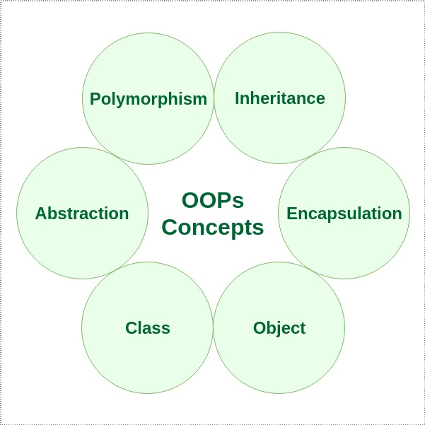
OOP Concepts

Slide 6
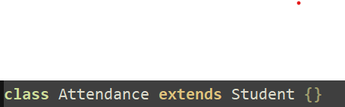
Inheritance
Inheritance in Java is the method to create a hierarchy between classes by inheriting from other classes

Slide 7
Polymorphism
There are two types of polymorphism in Java,
  Compile time polymorphism.
  Run time polymorphism.
The word polymorphism means having many forms. In simple words, we can define polymorphism as the ability of a message to be displayed in more than one form.

Slide 8
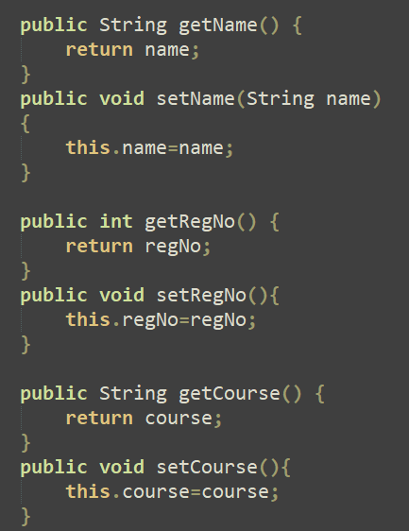
Encapsulation
Encapsulation in Java refers to integrating data (variables) and code (methods) into a single unit.

Slide 9
Abstraction
Abstract Class in Java does the process of hiding the intricate code implementation details from the user and just provides the user with the necessary information.
Abstraction can be achieved with either abstract classes or interfaces.

Slide 10

Class
What is class in a Java?
  A class in the context of Java is a template used to create objects and to define object data types and methods. Classes are categories, and objects are items within each category.

Slide 11
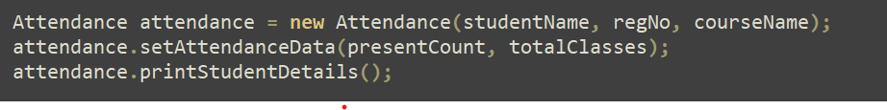
Object
What is an Object in Java. In the Java programming language, an object is an instance of a Java class, meaning it is a copy of a specific class.

Slide 12
About our project
In this project, we are going to check the attendance percentage of a student and the student is eligible for the exam or not.
As the final result of our project, displays the student details, attendance percentage of the student and the student can sit or not in the exam.
Let’s move to the code.

Slide 13
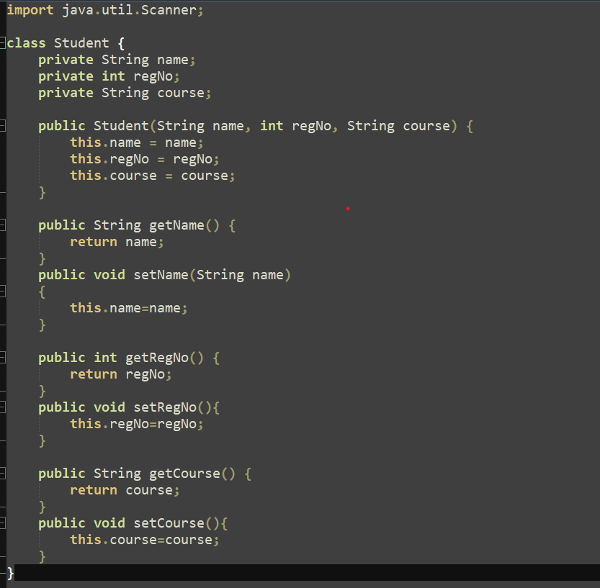

Slide 14
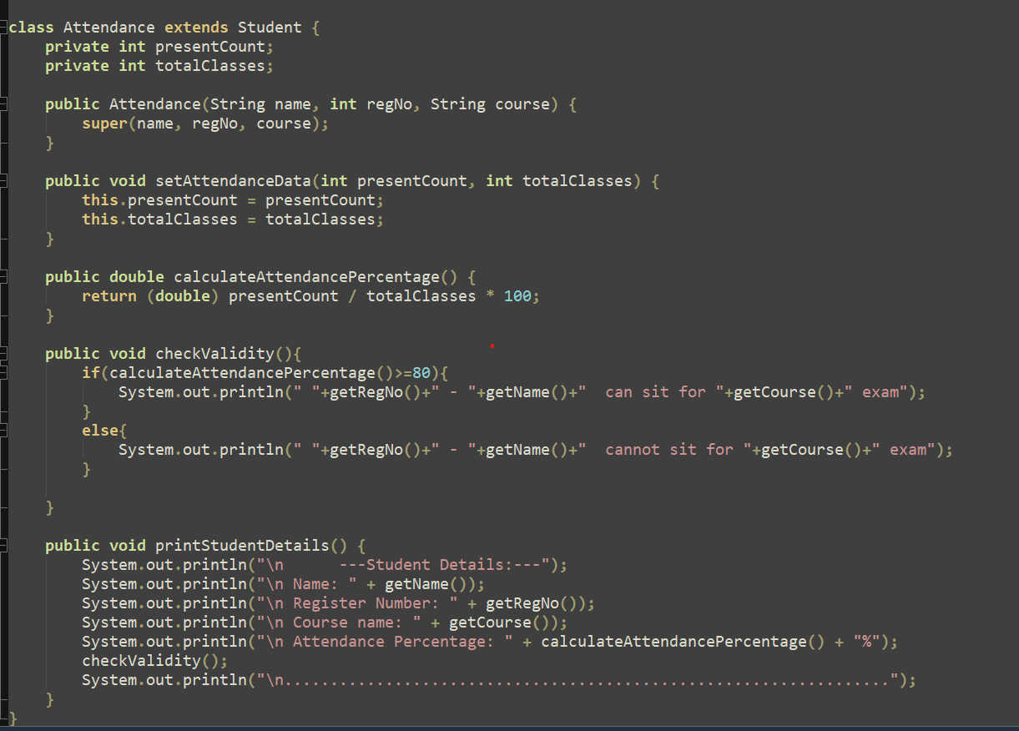

Slide 15
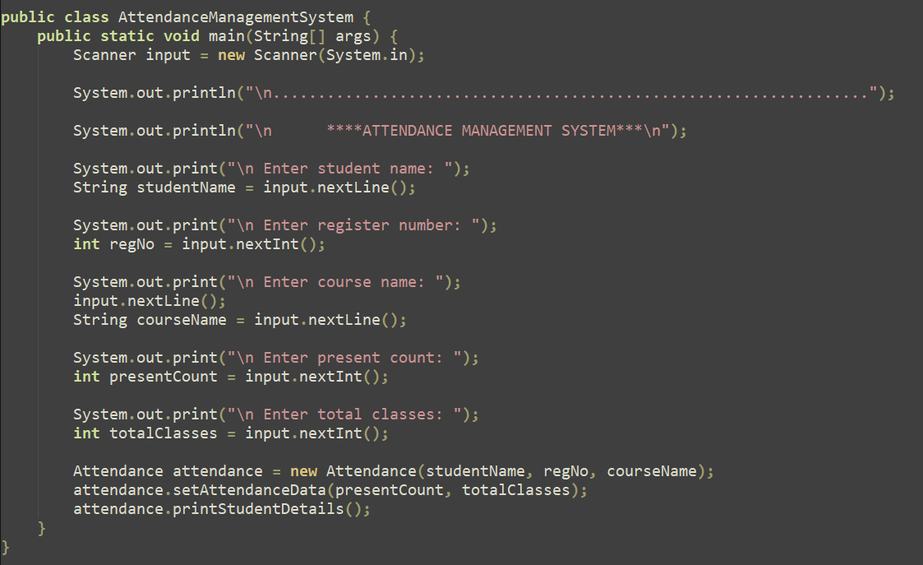

Slide 16
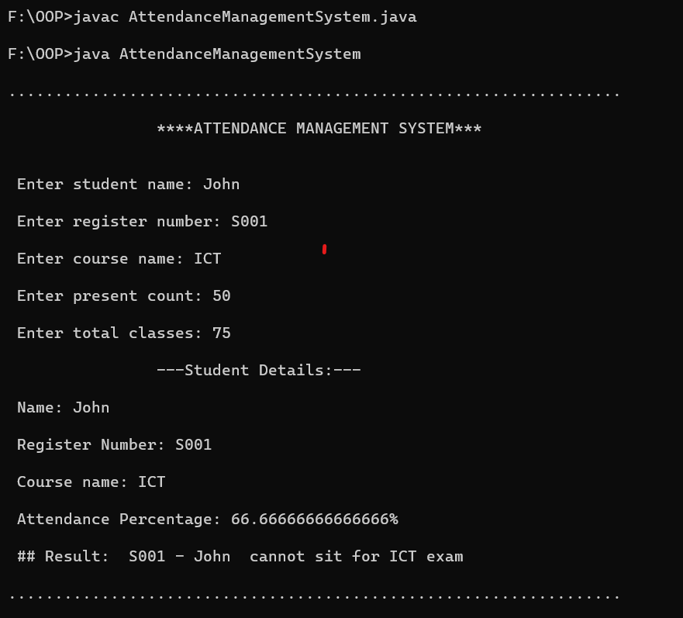
Output

Slide 17
